Slide 1
Freight Disruptors -- Forces Can Change Everything
Exploring Disruption: A Supply Chain Focus on Trends and Technologies Effecting Transportation and the Rest of our Lives
Robert L James Esq.
OLLI Presentation Two
March 25, 2022

Slide 2
Review -- Our Focus is on Transportation and Supply Chain Disruptors
Hardware Critical
Self Driving Cars and Trucks
Hybrid/ Electric Vehicles (Renewable Electricity}
Drones (and Delivery Bots)
Software (Digital) Critical
A-I, Internet of Things, Big Data
Block Chain
Mixed
3-D Printing (Additive Manufacturing
Robotics/Machine Learning
Disruptor Businesses
Tesla, Google, Apple, Amazon

Slide 3
Exploring Disruption: Impacts of Autonomous (AV)and Electric Vehicles (EV) On Future Mobility
Define Terms and Development Imperatives
Review Development History
Highlight Market and Players
Discuss Current State of theTech (Convergence)
Examine Present and Potential Future Impacts
Explore Benefits and Negatives in Relationship to Safety, Environmental, Economic and Social Goals

Slide 4
Key Definitions
Autonomous (Self Driving)Vehicle
Electro Mobility (e-Mobility)
An autonomous vehicle is one that can drive itself from a starting point to a predetermined destination in “autopilot” mode using various in-vehicle technologies and sensors, including adaptive cruise control, active steering (steer by wire), anti-lock braking systems (brake by wire), GPS navigation technology, lasers and radar.
Source: Gartner Glossary -- https://www.gartner.com/en/information-technology/glossary/electro-mobility-e-mobility
Electro mobility (or e-Mobility) represents the concept of using electric powertrain technologies, in-vehicle information, and communication technologies and connected infrastructures to enable the electric propulsion of vehicles and fleets. Powertrain technologies include full electric vehicles and plug-in hybrids, as well as hydrogen fuel cell vehicles that convert hydrogen into electricity.

Slide 5
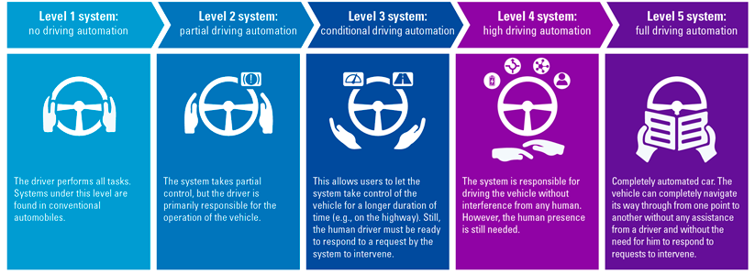
Autonomous Vehicles – Stages of Development Most autos now at Level 2 –some Tesla, Cadillac, Audi approach Level 3

Slide 6
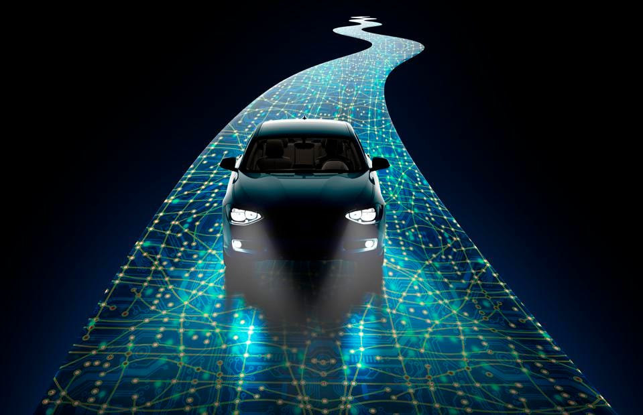
Examples of Common Levetl1-2 AV Systems
Adaptive Cruise Control (ACC)
Adaptive Front Light (AFL)
Automatic Emergency Braking (AEB)
Blind Spot Detection (BSD)
Cross Traffic Alert (CTA)
Driver Monitoring System (DMS)
Forward Collision Warning (FCW)
Intelligent Park Assist (IPA)
Lane Departure Warning (LDW)
Night Vision System (NVS)
Pedestrian Detection System (PDS)
Road Sign Recognition (RSR)
Tire Pressure Monitoring System (TPMS)
Traffic Jam Assist (TJA)
Source: https://www.marketsandmarkets.com/Market-Reports/near-autonomous-passenger-car-market-1220.html

Slide 7
AV Developmental Timeline
Pre-digital age AV development highlighted technology that employed a track embedded in the pavement for vehicles to follow and employed cameras and radar related devices for environmental recognition.
AV research started in the 1980s when universities began working on two types of AVs: one that required roadway infrastructure and one that did not.¹
The U.S. Defense Advanced Research Projects Agency (DARPA) has held “grand challenges” testing the performance of AVs on a 150-mile off-road course.
No vehicles successfully finished the 2004 Grand Challenge, but five completed the course in 2005.¹ In 2007, six teams finished the third DARPA challenge, which consisted of a 60-mile course navigating an urban environment obeying normal traffic laws.
In 2015, the University of Michigan built Mcity, the first testing facility built for autonomous vehicles. Research is conducted there into the safety, efficiency, accessibility, and commercial viability of Avs
For a thorough timeline discussion checkout: “The History of Self-Driving Cars: Computer Vision and Deep Learning” https://www.youtube.com/watch?v=BVRMh9NO9Cs
Source for text: https://css.umich.edu/factsheets/autonomous-vehicles-factsheet
Source for graphic: https://www.agf.com/ca/en/insights/market-commentaries/articles/article-a-driverless-world.jsp

Slide 9
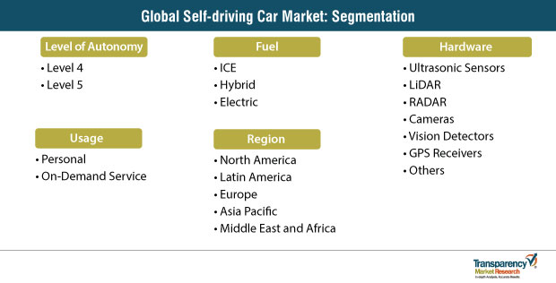
Projected AV Growth and Service Providers
The global autonomous vehicle market was estimated USD 94.43 billion in 2021 and is projected to hit around USD 1808.44 billion by 2030, poised to grow at a compound annual growth rate (CAGR) of 38.8% from 2021 to 2030.
In a lengthy autonomous vehicle market report published by GreyB, they predict that 25% of the total cars sold in 2035 are projected to be autonomous vehicles comprising 15% partially-autonomous vehicles and 10% fully autonomous cars.
The diverse companies bottom left are in the hunt for the nearly $ 20B vehicle market projected by 2030. And there is major co-dependency between the AI software providers, the major auto manufactures and the OEM providers that is resulting in increased cross alliances to rapidly developing the right mix technology to created a product that is safe, affordable and profitable.
The current results in investing in AV technology is not positive Companies have poured over $100 billion in R&D but the success is nowhere to be seen. Even leaders such as Waymo are providing their services in very limited cities.
There are over 60 companies that applied to get the permit to test their driverless vehicles in California but only 6 companies got the license to test their vehicles without drivers on public roads.
While the testing is still ongoing, it would take more than a decade for these vehicles to adapt to public roads of different cities. Because different cities have different traffic situations.
Despite billions in investment, they haven’t had much success. And the most affected are startups even if the research is going well. Waymo, which once valued at $200 billion now has a valuation of $30 billion.
but manufacturers have decided that the future of their industry requires a shift to AV and EV based products, (See Top 30 Autonomous Vehicle Technology and Car Companies – GreyB )
Chart Source: Autonomous Vehicle Market Size, Share, Trends, Report 2022-2030 (precedenceresearch.com)

Slide 10
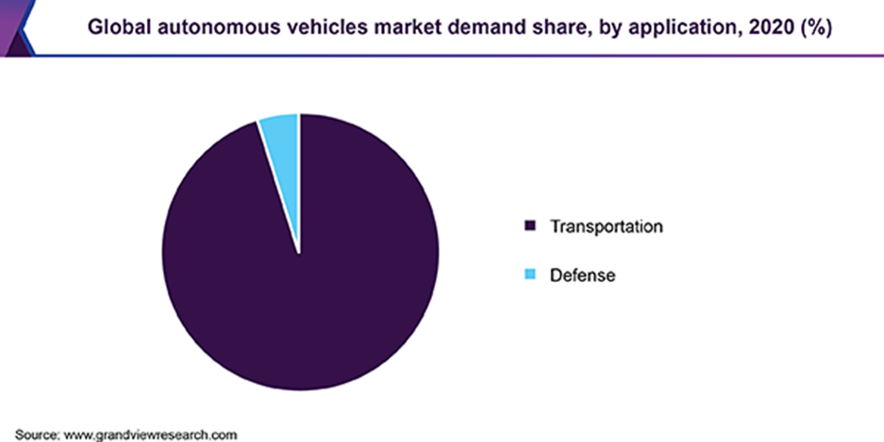
Global Market Descriptors

Slide 11
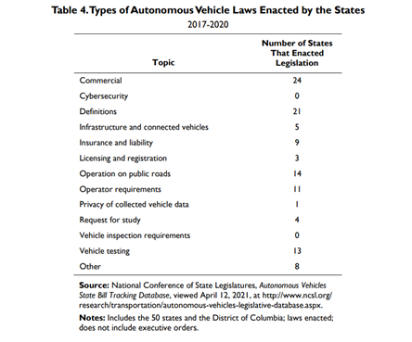
Issues and Status of Government Regulation
Nowhere in the United States is it strictly illegal to own or operate a self-driving car. Many states have passed laws regulating or authorizing the use of autonomous vehicles to prepare for the changes that self-driving cars may bring. But no state has outright banned the technology.
Federal Level legislation has been proposed to clarify terms of development and regulations between the federal government and states. No legislation has passed. However, NHTSA has established guidelines for State regulators that would help them measure the safety and effectiveness of AV systems As ever, the promotion of safe operation is the primary concern as well as economic development and global competitiveness.
There is tension between AV proponents who want policies and rules that favor its rapid advancement and those that are want to move with slow deliberate speed in introducing these vehicles on US highways.
Good summaries of AV regulator issues and status can be found at the following links: Congressional Research Service (CRS) Issues in Autonomous Vehicle Testing and Deployment (congress.gov) and ”Are Self-Driving Cars Legal in Your State?” https://www.lifewire.com/are-self-driving-cars-legal-4587765

Slide 12
Outstanding AV Policy issues identified by the CRS
“The extent to which Congress should alter the traditional division of vehicle regulation, with the federal government being responsible for vehicle safety and states for driver-related aspects such as licensing and registration, as the roles of driver and vehicle merge.
The number of autonomous vehicles that NHTSA should permit to be tested on highways by granting exemptions to federal safety standards, and which specific safety standards, such as those requiring steering wheels and brake pedals, can be relaxed to permit thorough testing.
How much detail legislation should contain related to addressing cybersecurity threats, including whether federal standards should require vehicle technology that could report and stop hacking of critical vehicle software and how much information car buyers should be given about these issues.
The extent to which vehicle owners, operators, manufacturers, insurers, and other parties have access to data that is generated by autonomous vehicles, and the rights of various parties to sell vehicle-related data to others.”

Slide 13
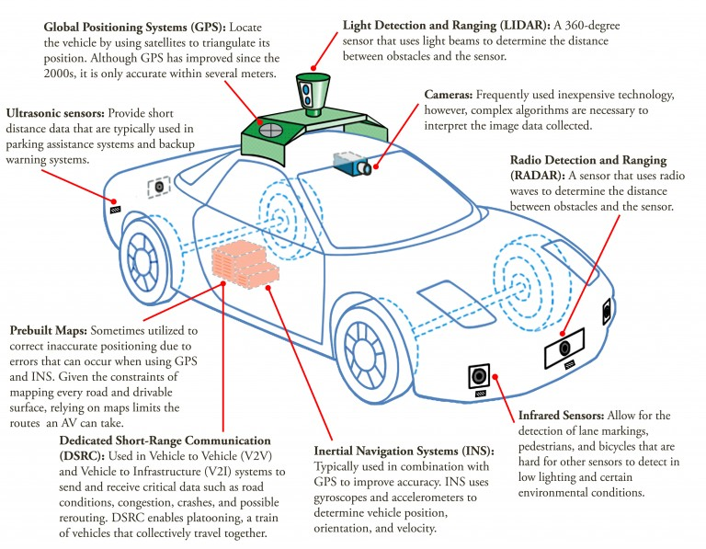
Essential AV Technological Elements -- https://www.youtube.com/watch?v=taMP_n3wL7M

Slide 15
Real World Experience with Current “Self-Driving” Auto Technology
CBS Morning Reports – Expect to Waiting 50years for level 5 capability
https://www.youtube.com/watch?v=W3n6bhl2FJI

Slide 16
Real World Experience with Current “Self-Driving” Auto Technology
Black Tesla takes on NYC – AV tech frustrated by congestion, buses, pedestrians and lane mergers
https://youtu.be/NbkqkSP1P6o

Slide 17
Autonomous Trucks – “A train on software rails”
But Obstacles remain
The Case for Development is strong
Trucking needs them to ease their driver shortage, lower costs and keep their competitive advantage vs. Rail Intermodal
They may advance safety by eliminating driver error accidents
They can maximize fuel efficient operations
A strong, international mix of start -ups and existing truck manufacturers are competing for the market e.g. Otto, Waymo, Freightliner
Videos: https://www.youtube.com/watch?v=dWU3i5uDX24&t=218s
autonomous trucking - YouTube
Technology is advancing but not fully realized.
Lacking common development platforms.
Truckers and the general public are skeptical
Major status quo resisters –think accident claims and resolution industry
Decentralized regulatory authority at state and federal level
Cybersecurity fears
Trucking Driving and Rail Job loses.*
Wildcard: Competition with China
*Such a system, according to a new study out of the University of Michigan, could replace about 90% of human driving in U.S. long-haul trucking, the equivalent of roughly 500,000 jobs.

Slide 19
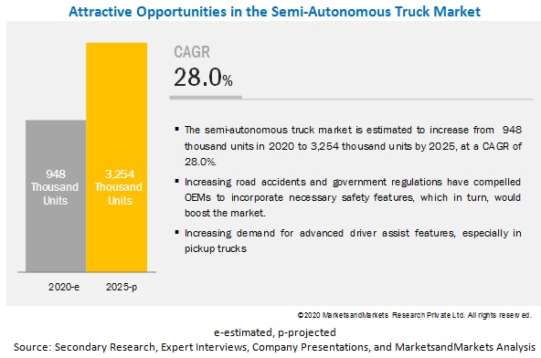
Estimated Growth Within the Semi and Full AV Truck Market
Semi-autonomous truck technology requires human intervention to control the vehicle while simultaneously using some of the advanced technologies such as Adaptive Cruise Control (ACC), Lane Assist (LA), Blind Spot Detection (BSD and others to increase passenger safety and reduce the efforts required for driving trucks. Whereas fully-autonomous trucks run an artificial intelligence program that controls the entire vehicle without any human intervention while driving.
Top Players
AB Volvo (Sweden)
Robert Bosch (Germany)
Continental AG (Germany)
Denso (Japan)
Aptiv (UK)
Daimler (Germany)
Paccar (US)
Nvidia (US)
Top Start-ups
Embark (US)
Waymo (US)
TuSimple (US)
Tesla (US)
Source: https://www.marketsandmarkets.com/Market-Reports/semi-autonomous-truck-market-224614273.html

Slide 20
Key AV Truck Market Drivers, Restraints and Applications
Key Drivers:
Increasing emphasis on better road safety and traffic control
Ability of autonomous and semi-autonomous trucks to alleviate truck driver shortage
Economic effect of autonomous & semi-autonomous trucks on the trucking industry
Key Restraints:
Cybersecurity and data privacy concerns
High cost of development
Lack of information technology and communication infrastructure in developing nations
Key Technology Applications
Level 4 Autonomous Truck – Level 4 trucks are highly automated trucks in which the system controls the steering, acceleration, and braking. The driving environment and dynamic driving tasks are also monitored and performed by the system. A vehicle with level 4 capability can do all the driving, but only in certain circumstances. The autonomous driving system notifies the driver when he can switch to the autonomous driving mode.
Last Mile Delivery Truck – Last mile delivery trucks are used for logistics purposes in the distribution centre or facility to the end-user. These trucks are witnessing high demand due to the rise of the e-commerce sector. The aim is to be able to deliver goods at consumer end in specific time without delays and to reduce the delivery cost to the company. Using autonomous last mile delivery trucks can help companies save 40% of the total cost.
Truck Platooning – In truck platooning, two or more trucks are connected in a group with the help of connectivity technologies, autonomous driving, and artificial intelligence support systems such as adaptive cruise control and lane assist. These vehicles automatically keep a set close distance between each other. The truck at the head of the platoon acts as a leader, with the vehicles behind adapting and reacting to changes in its movement, requiring little or no action from the driver.

Slide 21
Platooning -- One Path for Autonomous Trucks Roll Out https://www.youtube.com/watch?v=X7vziDnNXEY

Slide 23
Major Present and Future AV Issues - 1
Regulations, Liability, and Projected Timeline
Regulation will directly impact the adoption of AVs. There are no national standards or guidelines for AVs, allowing states to determine their own.
In 2018, Congress worked to pass the AV Start Act that would have implemented a framework for the testing, regulating, and deploying of AVs. The legislation failed to pass both houses. As of February 2020, 29 states and D.C. have enacted legislation regarding the definition of AVs, their usage, and liability, among other topics.
Product liability laws need to assign liability properly when AV crashes occur, as highlighted by the May 2016 Tesla Model S fatality. Liability will depend on multiple factors, especially whether the vehicle was being operated appropriately to its level of automation.
Although many researchers, OEMs, and industry experts have different projected timelines for AV market penetration and full adoption, the majority predict Level 5 AVs around 2030 -- other 2040 or 2050
Source: Center for Sustainable Systems, University of Michigan. 2021. “Autonomous Vehicles Factsheet.” Pub. No. CSS16-18. September 2021

Slide 24
Major Present and Future AV Issues - 2
Current Limitations and Barriers
There are several limitations and barriers that could impede adoption of AVs, including:
the need for sufficient consumer demand,
assurance of data security,
protection against cyberattacks,
regulations compatible with driverless operation,
resolved liability laws,
societal attitude and behavior change regarding distrust and subsequent resistance to AV use, and the development of economically viable AV technologies.
Weather can adversely affect sensor performance on AVs, potentially impeding adoption.
Impacts, Solutions, and Sustainability
Although AVs alone are unlikely to have significant direct impacts on energy consumption and GHG emissions, when AVs are effectively paired with other technologies and new transportation models, significant indirect and synergistic effects on economics, the environment, and society are possible. (e.g., Reuse of Parking Space)
One study found that when eco-driving, platooning, intersection connectivity and faster highway speeds are considered as direct effects of connected and automated vehicles, energy use and GHG emissions can be reduced by 9%.
Source: Center for Sustainable Systems, University of Michigan. 2021. “Autonomous Vehicles Factsheet.” Pub. No. CSS16-18. September 2021

Slide 25
Potential AV Benefits
Vehicular Safety (In 2019, U.S. annual vehicular fatality rate was 36,096; 94% of crashes are due to human error. AVs have the potential to remove/reduce human error and decrease deaths.26,27 AVs have the potential to reduce crashes by 90%, potentially saving approximately $190 billion per year)
Self-driving cars follow traffic rules
Robots have higher attention spans
Improvements in mobility for people who can’t drive
More convenient driving experience
Potential lower insurance costs
Potential lower insurance costs
May be faster on average
Makes working while driving possible
Savings on fuel
Improvements in air quality
Reduction in car thefts
Reduction of fatalities due to driver mistakes
Economic advantages

Slide 26
Potential AV Negative Impacts
Higher unemployment rate since fewer cab drivers are needed
People may unlearn how to drive manually
Higher congestion levels
High R&D costs
High initial purchase price
Maintenance may be difficult and costly
Privacy concerns
Moral concerns
Technical errors
Hacking issues
Bad weather may prevent technical systems to work properly
People may not be willing to accept this technology
High regulatory restrictions
Insurance issues
Benefits and Negatives Source: See https://environmental-conscience.com/self-driving-cars-pros-cons/

Slide 27
Any Questions? (Next Week EVs Drones, Robotics)

