Slide 1
Freight Disruptors -- Forces Can Change Everything
Exploring Disruption: A Supply Chain Focus on Trends and Technologies Effecting Transportation and the Rest of our Lives
Robert L James Esq.
OLLI Presentation Four – AI, Machine Learning and Big Data and More
March, 2022

Slide 2
Exploring Disruption: Impacts of Artificial Intelligence and Related Technologies on Transportation and Logistics
Define Terms and Development Imperatives
Review Development History
Discuss Current State of AI and related Technology
Identify Market and Key Actors
Examine Present and Potential Future Impacts
Explore Benefits and Negatives Discuss Takeaway Points

Slide 3
Key Definition – Artificial Intelligence (AI)
Artificial intelligence (AI) refers to the simulation of human intelligence in machines that are programmed to think like humans and mimic their actions. The term may also be applied to any machine that exhibits traits associated with a human mind such as learning and problem-solving.
The ideal characteristic of artificial intelligence is its ability to rationalize and take actions that have the best chance of achieving a specific goal
The goals of artificial intelligence include learning, reasoning, and perception.
Source: https://www.investopedia.com/terms/a/artificial-intelligence-ai.asp#:~:text=Artificial%20intelligence%20(AI)%20refers%20to,as%20learning%20and%20problem%2Dsolving.
Artificial intelligence can be divided into two different categories: weak and strong. Weak artificial intelligence (aka –narrow AI) embodies a system designed to carry out one particular job. Weak AI systems include video games such as the chess example from above and personal assistants such as Amazon's Alexa and Apple's Siri. You ask the assistant a question, it answers it for you (i.e., Google Maps).
Strong artificial intelligence systems are systems that carry on the tasks considered to be human-like. These tend to be more complex and complicated systems. They are programmed to handle situations in which they may be required to problem solve without having a person intervene. These kinds of systems can be found in applications like self-driving cars (i.e., self driving vehicles.)

Slide 4
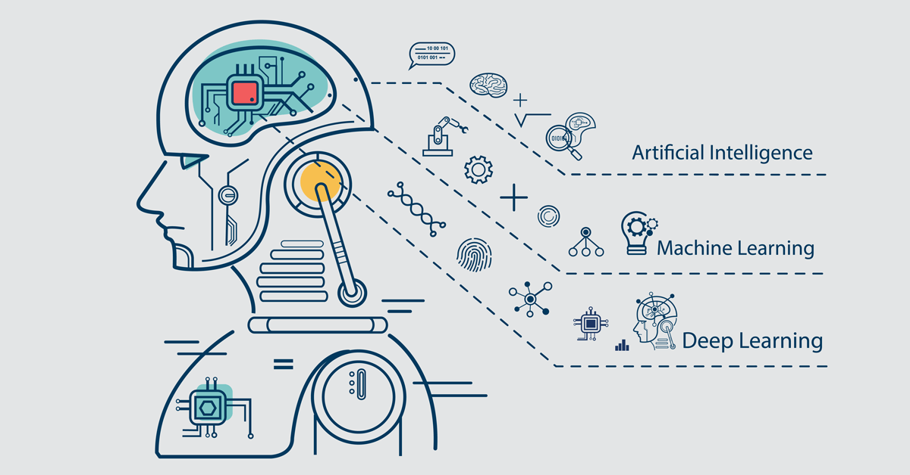
Important AI Sub Concepts
Machine learning is the general term for when computers learn from data. It describes the intersect of computer science and statistics where algorithms are used to perform a specific task without being explicitly programmed; instead, they recognize patterns in the data and make predictions once new data arrives.
Examples: Predictive Travel Demand and Equipment Maintenance Models,
Deep learning describes algorithms that analyze data with a logic structure similar to how a human would draw conclusions. To achieve this, deep learning applications use a layered structure of algorithms called an artificial neural network (ANN). The design of such an ANN is inspired by the biological neural network of the human brain, leading to a process of learning that’s far more capable than that of standard machine learning models. Deep learning has huge data needs and can be supervised or unsupervised but requires little human intervention to function properly.
Examples: Automated Motor Vehicles
Natural Language Processing: NLP is a science that is used by machine humans to understand and interpret a language, once it knows the intention of a human being, then after that, he starts working in the same way.
Examples: Siri, Alexa
Source: https://levity.ai/blog/difference-machine-learning-deep-learning
Computer Vision: Computer vision helps to study and understand an image and object by dividing it into many different ways. Under this algorithm so that the machine can make the correct decision based on the previous observations.
Examples: Drone sight, 3 D Mapping
Cognitive Computing: The cognitive computing algorithm tries to mimic text, photos, etc. try to give the desired output in the same way that the human brain mimics it.
Example: Big Data Accident Analysis

Slide 5
Major AI Development Pathways
Illustration Consider the task of building a system, equipped with an optical scanner, that recognizes the letters of the alphabet.
A top-down approach typically involves writing a computer program that compares each letter with geometric descriptions.
A bottom-up approach typically involves training an artificial neural network by presenting letters to it one by one, gradually improving performance by “tuning” the network. (Tuning adjusts the responsiveness of different neural pathways to different stimuli.)
Source: https://www.britannica.com/technology/artificial-intelligence/Reasoning
.
AI research follows two distinct, and to some extent competing, methods, the symbolic (or “top-down”) approach, and the connectionist (or “bottom-up”) approach.
Symbolic A top-down approach that seeks to replicate intelligence by analyzing cognition independent of the biological structure of the brain, in terms of the processing of symbols—hence the symbolic label. (Writing a computer program to recognize common element of shapes and symbols inherent in specific data.)
Connectionist The bottom-up approach, on the other hand, involves creating artificial neural networks – the pathways to pattern recognition -- in imitation of the brain’s structure. The AI program follows the way the mind would weigh and react to different stimuli --hence the connectionist label.

Slide 6
AI Development Timelines - 1

Slide 7
AI Development Timelines - 2

Slide 8
AI Development Video : https://www.youtube.com/watch?v=056v4OxKwlI

Slide 9
DHL Transport Technology Trends Dominated by AI

Slide 10
AI Market Characteristics

Slide 11
AI Market Characteristics II

Slide 12
Key AI Areas Impacting Transportation
Motor Vehicles Manufacturing and Use:
AV and EV Navigation, Safety and Security
Logistics and Warehousing:
Robotics
Maintenance
Digital Data Transfer
Transactional Transparency
Predictive Analysis (Big Data)
Precision Mapping and Routing.
Intelligent Transportation Systems (ITS):
Traffic and Pedestrian Detection and Direction
Traffic Flow Analysis
Road Condition Monitoring
Law Enforcement
Driver Monitoring

Slide 13
Examples of AI Logistics Use Benefits
Robots and AI – Better manage support data as well as improve goods movement’
Warehouse Management– Get the big picture from big data, speed services and reduce mistakes
Predictive Maintenance – Avoid breakdowns, Schedule Repairs
Supply Chain Planning – Use ML to help balance supply & demand, optimize delivery processes,
Route Optimization – Combine digital tools and mapping for efficient shipping.
Workforce Planning -- Simplify and automate hiring, retention and general employee management
Yield Optimization – Better determine where inventory is being managed well or not.
Demand Prediction – Improve forecasting and deepen insight into factors controlling demand.

Slide 14
IoT Provides both the Score and Instruments for AI Development and Use

Slide 15
AI and Motor Vehicles – Think Bots as well as cars and Trucks
Video: https://www.youtube.com/watch?v=xEfrnXhTl4U&t=2s

Slide 16
IOT Logistics Applications –Resource Management
Location management systems
The Internet of Things can create smart location management systems that will enable companies to easily track driver activities, vehicle location, and delivery status. Once goods are delivered or come to a certain place, a manager is notified by a push message
Supply chain management
Supply chain management carries various challenges from illegal food practices to taking care of product conditions. The placement of radio frequency identification tags and sensors will allow monitoring of things such as product temperature and humidity, vehicle location, and stages of transportation processes. The data is recorded and saved -- every product is given a digital ID that secures information about it along with the product lifecycle.

Slide 17
AI Fleet Management Video Video https://www.youtube.com/watch?v=2qZmFcwQ2Mw

Slide 18
AI/IOT Smart Warehouse Features
Automated Picking (Find, sort and deliver devices)
Industrial IoT (RFID tracking, automated building systems controls)
Automated Machines (Forklifts, pallet movers, drones)
Smarter Layouts (Big date assisted efficiency and safety designs )
Voice Assistants (Siri for order fulfillment)
Augmented Reality Wearables (Google Glasses)
Renewable Energy Systems (The answer is Blowin’ in the wind –and soaking up the sun)
Text: https://supplychainbeyond.com/7-big-trends-in-warehouse-automation/
Video: Inside Amazon's Smart Robot Warehouses, How Amazon Robots Work, Jeff Bezos Smart Warehouse https://www.youtube.com/watch?v=Jh27vjAhE-c
Graphic Source: . INTERNET OF THINGS IN LOGISTICS A COLLABORATIVE REPORT BY DHL AND CISCO ON IMPLICATIONS ANDUSE CASES FOR THE LOGISTICS INDUSTRY

Slide 20
AI and Intelligent Transportation Systems – Perfect Together
An intelligent transportation system (ITS) is a technology, application or platform, that improves the quality of transportation or achieves other outcomes based on applications that monitor, manage or enhance transportation systems. Technopedia,
ITS Traffic Information Transfer System
Intelligent Transportation Systems rely heavily on data collection and analysis. Results are then used control, manage and plan transportation. Sensors play an important role in data collection. In other words, ITS needs and AI products work well together.
AI assisted “smart streets” applications include:
Real-time parking management
Electronic toll collection
Emergency vehicle notification systems
Automated road speed enforcement
Speed alerts
RFID in freight transportation
Variable speed limits
Dynamic traffic light sequence
Collision avoidance systems
Text source: https://www.aindralabs.com/what-is-intelligent-transportation-system-its-applications-and-examples/
Videos: https://youtu.be/OnjX0O9dPMc?list=PLvk6TIjIP8_39VQcCxba3hplGSA4P50RP
https://youtu.be/dS4pWnNlxfA?list=PLvk6TIjIP8_39VQcCxba3hplGSA4P50RP

Slide 23
Pro and Cons of AI Transportation Technology
Pros
Cons
Generally advances transportation safety
Can strongly contribute to emissions reductions and environmental improvement
Improves supply chain efficiency
Reduces human work risk in threatening environments
Increases mobility options for the handicapped
Builds knowledge bases and analytical resources
Increases efficient data transfer and transparency
Reduces employment opportunities in key sectors
Raises terrorist threat levels
Creates new cybersecurity threats
Back box algorithms can distort critical data and analysis
Increases dependency on machines
Raises opportunities for fraud
Increase wealth gap between communities and nations
Complacency can cause human to lose control.

Slide 24
Takeaways
AI is a simulation of human intelligence essentially a mimicry of human thought and action. It is a very effective substitute for tasks that can be machine learning by symbolism or rote –and even where complex instruction can be tied to specific tasks.
AI’s goal -- to use scientific means to duplicate human thought and actions – is inherently troublesome and controversial. OK for automatic toll collection but more concerning when used to create driverless vehicles -- even under the common banner of efficiency and safety.
To wit, the development of technologies like Natural Language Programs (NLP) and the Internet of Things (IoT), suffer from the diverse social inputs and ambiguity of language/words the processes they would apply. This makes it hard to develop a neutral, common, or equitable bases for algorithms to be universally applied. (Their box translations may hide a black heart).
The goal of AI technology use in transportation -- or otherwise -- should be the increase of our ability to work smarter and faster. Thus we create more time to use of our higher intellectual gifts for work or just to have fun. Yet AI can lead to joblessness not only for equipment operators or bill agents but for “professionals” as well.
How far are we willing to go to substitute machine functions for human activity?
Why?

Slide 25
Moreover
AI transportation tools offer powerful means to improve the machines and the information systems required for efficient, cost-effective commerce., as well as the ability to create and serve new markets.
However, in duplicating and reducing human involvement in work and recreation --and in favoring productive efficiency over unemployment consequences -- AI can undermine its inherent value to human progress; it comes with the risk of creating a more indolent and inequitable society.

Slide 26
Last Thoughts – AI Oh Really?
Many agree with Noam Chomsky, a linguist at the Massachusetts Institute of Technology (MIT), who opined that a computer beating a grandmaster at chess is about as interesting as a bulldozer winning an Olympic weightlifting competition.

Slide 27
Bonus I – Turing Test
What Is the Turing Test?
The Turing Test is a deceptively simple method of determining whether a machine can demonstrate human intelligence: If a machine can engage in a conversation with a human without being detected as a machine, it has demonstrated human intelligence.
The Turing Test was proposed in a paper published in 1950 by mathematician and computing pioneer Alan Turing. It has become a fundamental motivator in the theory and development of artificial Intelligence (AI).¹
KEY TAKEAWAYS
The Turing Test judges the conversational skills of a bot.
According to the test, a computer program can think if its responses can fool a human into believing it, too, is human.
Not everyone accepts the validity of the Turing Test, but passing it remains a major challenge to developers of artificial intelligence.
https://www.investopedia.com/terms/t/turing-test.asp

Slide 28
Bonus II Asimov’s Laws: Don’t Harm, Obey, Protect

