Slide 1
Freight Disruptors -- Forces Can Change Everything
Exploring Disruption: A Supply Chain Focus on Trends and Technologies Effecting Transportation and the Rest of our Lives
Robert L James Esq.
OLLI Presentation Three– EVs, Drones and Bots
March, 2022

Slide 2
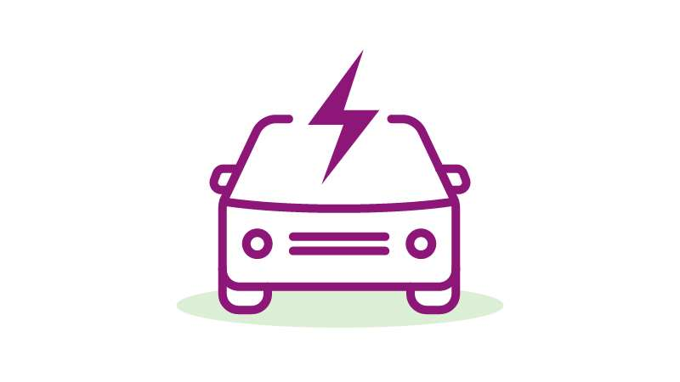
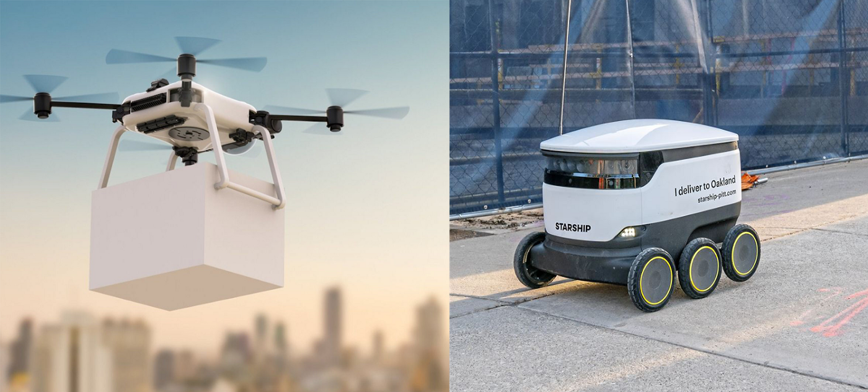
Exploring Disruption: Impacts of and Electric Vehicles (EVs) and Last Mile AVs On Future Mobility and “last mile” technology (e.g., drones and bots)
Define Terms and Development Imperatives
Review Development History
Discuss Current State of the Technology (Convergence)
Highlight Market and Key Actors
Examine Present and Potential Future Impacts
Explore Benefits and Negatives in Relationship to Safety, Environmental, Economic and Social Goals

Slide 3
Key Definitions -- Electric Mobility/ Electric Vehicles
Electro mobility (or e-Mobility) represents the concept of using electric powertrain technologies, in-vehicle information, and communication technologies and connected infrastructures to enable the electric propulsion of vehicles and fleets.
Powertrain technologies include full electric vehicles and plug-in hybrids, as well as hydrogen fuel cell vehicles that convert hydrogen into electricity.
The term ‘electric vehicle’ or ‘EV’ covers any vehicle that operates on an electric motor or traction motor instead of an Internal Combustion Engine (ICE). This includes not only cars but electric trucks, planes, trains, boats and two- and three-wheelers.
Battery Types of EVs
Battery Electric (BEVs)
Plug-in Hybrids (PHEVs)
Hybrid Electrics (HEVs)
Hydrogen Fuel Cells – the Challenger
Fuel Cells
Text Source: Gartner Glossary -- https://www.gartner.com/en/information-technology/glossary/electro-mobility-e-mobility

Slide 4
EV Type Differences Explained
Battery Electric Vehicles (BEVs) Battery electric vehicles - often referred to as ‘fully-electric’ or ‘all-electric’ vehicles - are vehicles fitted with a rechargeable battery as the sole power source. They have no gasoline engine at all. BEVs store electricity onboard with high-capacity (usually lithium-ion) battery packs. Their battery power is then used to run the electric motor and onboard electronics. Due to the absence of an ICE, BEVs do not emit any harmful emissions at all. BEVs are charged by electricity from an external power source, with their chargers classified according to the speed at which they recharge a battery. Examples of BEVs include the Tesla Model 3, BMW i3, Volkswagen e-Golf, and the Hyundai Ioniq.
Plug-in Hybrid Electric Vehicles (PHEV) The plug-in-hybrid electric vehicle combines a battery and electric motor with an economical petrol or diesel engine. PHEVs can be recharged by plugging into an external electricity source. In addition, PHEVs can also be powered by their onboard engines and generators, and they’re able to substitute electricity from the grid for gasoline. In a PHEV, the onboard battery will usually be much smaller and have a lower capacity than those found in all-electric cars. This means that PHEVs can’t drive very far on electricity alone, requiring the combustion engine to eventually kick in. Examples of PHEVs include the BMW i8, Toyota Prius, Ford C-Max Energi, and the Mini Cooper SE Countryman.
Hybrid Electric Vehicles (HEVs) Hybrid electric vehicles are powered by both fossil fuels and electricity. In a HEV, electricity is generated by the car’s braking system and this is used to recharge the battery. This is known as ‘regenerative braking’, a process whereby the electric motor helps to slow and bring the vehicle used to a stop using some of the energy normally converted to heat by the brakes. HEVs start off their journeys using the electric motor, then the ICE engine steps in as load or speed rises. HEVs are very similar to PHEVs except that they can’t be plugged in; electricity can only be generated via regenerative braking. Examples of HEVs include the Toyota Rav 4 Hybrid, the Honda Civic Hybrid, and the Toyota Camry Hybrid.
Fuel Cell Vehicles Some electric cars get their electricity from a hydrogen fuel cell instead of a battery. As such, these vehicles are referred to as ‘fuel cell vehicles.’ While there are many different types of hydrogen fuel cell at the moment, most of them have the same working principle: they combine hydrogen and oxygen to produce electricity (to propel the vehicle) and water (by-product). As hydrogen fuel cell cars are powered by this chemical process, they do not need to be recharged and can be driven so long as they are fueled by a supply of hydrogen. Filling up the car can take less than five minutes, with the average range of hydrogen fuel cell cars sitting around 300-350 miles. Two examples of hydrogen fuel cell vehicles are the Toyota Mirai and the Hyundai Nexo.
Source: https://www.power-and-beyond.com/electromobility--electric-vehicle-basics-how-they-work-and-how-theyre-powered-a-997269/ 04/02/21

Slide 5
How Electric Vehicles Work
All EVs are powered by an electric motor. This gets its power from a stack of batteries, and in most cases electric cars must be plugged in to recharge these batteries. Nowadays, most electric cars will use lithium-ion batteries.
Batteries In EVs - electric cars especially - the batteries are usually found positioned low down in the car. In the Tesla, for example, the battery runs along the floor. Due to the weight of the batteries (the average electric car weighs more than the average fuel-powered car!), this helps to regulate the car’s center of gravity. Electric cars will also usually feature an auxiliary battery that is used to power the car’s non powertrain electrics, much like the battery found in a conventional fuel-powered vehicle.
Electric motor The electric motor draws power from the battery to drive the car’s wheels and enable propulsion. Two motors can be used - one on each of the car’s two axles - to provide four-wheel drive. Today, all electric motors are fundamentally AC. They spin when the rotor chasing an alternating magnetic field is induced by an alternating electrical current.
Video: How Do Electric Vehicles Work? (178) How Do Electric Vehicles Work? - YouTube
Electric Chargers
Charging requires special cables and equipment and delivers power at three speeds.
Rapid, Available for high end models and at service locations along major routes. The average charges take one hour but 80% can be achieved in 20 minutes.
Fast: Fast chargers are usually rated at either 7 kW or 22 kW (single- or three-phase 32A). Charging time varies depending on unit speed, but a 7kW charger can recharge a compatible EV with a 40kWh battery in around four-to-six hours, and a 22kW charger in one-to-two hours. Fast chargers are typically found at longer term parking locations such as supermarkets, car parks, and leisure centers.
Slow: The most common slow chargers are rated at 3.6 kW (16A). Charging times vary depending on the type of charging unit and the EV that’s being charged. Generally, a full charge on a 3 kW unit will take anywhere between 6 and 12 hours. Slow charging is a common method used in home-based settings. Often, slow EV charging stations are deployed where cars may be left for longer periods, such as 24-hour public car parks and workplaces.

Slide 7
EV Historical Timeline

Slide 8
Videos Describing EV Historical Development
TED-Ed
The surprisingly long history of electric cars - Daniel Sperling and Gil Tal
353K views5 months ago

Slide 9
Videos Describing EV Historical Development
TED-Ed
https://www.youtube.com/watch?v=gE1neFrGcMs

Slide 10
Goals Alignment: EV’s are the Future

Slide 11
Key Performance Parameters: ICE vs. EV
Source: https://www.researchgate.net/publication/345392256_Performance_Characteristics_of_Lubricants_in_Electric_and_Hybrid_Vehicles_A_Review_of_Current_and_Future_Needs

Slide 12
The Tipping Point For EVs -- the Future is not now – but 2030 is a Major Target Date
Current Major Impediments:
Battery Technology Limitations and Development Uncertainties
Charging Methods and Facilities
Primary Sources of Electrical Power
Lack of Coordinated Governmental Response
Video:The EV Charging Problem: https://www.youtube.com/watch?v=pLcqJ2DclEg&t=907s

Slide 14
Sorting it Out : EV Batteries vs Hydrogen Fuel Cells.
Key Criteria
Cost and choice
Current BEVs a much less expensive current models are up to 5 times less to buy than FCEVs and cost less to run (even with 3 years of free fuel for Toyota Mirai}.
Winner – Batteries.
Charging/fueling station availability
There are restrictions in where you can drive your FCEV due to lack of facilities. Current infrastructure supporting BEVs that includes thousands of charging stations around the world, the same facilities don’t yet exist for fuel cells. There are only around 400 hydrogen fuel stations worldwide (of which a large number are private) and there are for example, only 16 stations in the UK.
Winner – electric cars.
Range
Because of the limited choice of fuel cell vehicles on the market, it makes comparing range between the two power options difficult. The longest range BEVs are comparable to average FCEVs performance which until recently seem to have an edge.
Winner – For now, hydrogen cars.
Emissions
Both BEVs and FCEVs emit zero emissions from their tailpipe during operation -- they both produce clean energy and are equally as eco-friendly to drive.
Manufacturing a lithium-ion battery can be a very energy intensive process and generates an estimated 20 tons of CO2 at creation. Fuel cellCO2 production averages between 80-124g/km of CO2 in use when taking into account charging inefficiencies.
The most practical current method to produce hydrogen gas comes from burning fossil fuels and leads to an estimated 120g/km of CO2 over the lifetime of a fuel cell. Yet If greener renewable sources are used to produce hydrogen, this figure could be a lot lower. The long term impacts are difficult to predict; currently its hard to tell which energy sources are used in production and both have real prospects to overcome many environmental limitations.
Winner – draw (inconclusive) but favoring batter is
Safety
Safety has been a key concern with fuel cells that has led many to assume they are too dangerous to utilize. However, new technologies have resolved many traditional safety issues associated with hydrogen including leakage threats.
Electric batteries in vehicles are troublesome too, with lithium-ion batteries being known to overheat and overcharge leading to numerous personal injuries through their use in laptops and phones. However, vehicle manufacturers strive to ensure their safety by regulating temperatures to avoid overheating and use multiple smaller batteries rather than larger ones to avoid overcharging.
New solid state battery technologies would lover or replace lithium content and ultimately favor battery use in smaller vehicles
Winner – a draw for now.
Major disadvantages: Hydrolysis Conversion Costs, Lack of Filling Stations
Major Advantages: Fast, convenient fueling, clean, infinite resource

Slide 15
Which of the two — batteries or hydrogen — is the alternative ‘fuel’ of the future? : Current Best Technology Depends on Type of Vehicle and Operating Circumstances
“Unfortunately, for those looking for a definitive response, the answer is both.
Battery-powered vehicles are certain to retain their advantage for the next few years while fuel cells struggle for the economies of scale and infrastructure that will open FCEVs to a wider market. Eventually, however, the adoption of hydrogen as a key part of our zero-emission future is inevitable.
Besides long-haul trucking, marine shipping and long-haul commercial aircraft are much better suited to hydrogen power.
Closer to home, taxi fleets and final-mile courier companies will likely find hydrogen more cost-effective. The production and distribution network needed to feed those industries is inevitable; it’s just a matter of when those economies of scale filter down to the automotive industry.”
CAVEAT: Major improvements on the horizon for BEV technology are on the horizon from Toyota, Tesla, and Chinese Companies
Blade Battery Video: https://www.youtube.com/watch?v=QMgg-dZrMtg
TextSource: Driving (CA) These numbers decide whether hydrogen or electric cars win out | Driving

Slide 17
Batteries and Energy Source Are Crucial for Decarbonization But…
Yes -- and more than ICE initially but the ICE emissions advantage disappears in less than two to five years depending upon use.
Yes -- but EVs are better than ICE, even with fossil fuel and the shift to green energy sources is accelerating and impactful.
Lithium (and Cobalt) are fraught with negative impacts but much less so than coal and gas. Nevertheless, there are major social justice and national security lurking here issue.
Source and Video: Are Electric Cars Worse For The Environment? Myth Busted
https://www.youtube.com/watch?v=6RhtiPefVzM

Slide 19
US Charging Stations – January 2022
In January 2022, the U.S. had almost 113,600 charging outlets for plug-in electric vehicles (EVs). A considerable sum of these chargers is found in California, with almost 41,300 public and private power outlets. Plug-in power stations and charging outlets are essential to increase U.S. plug-in electric vehicle sales.
Outlets supporting the EV boom Having a network of charging stations and outlets is absolutely necessary for electric vehicles to be practical for most drivers. Therefore, that China is among the leading markets for electric vehicle sales is unsurprising. The country has 800,000 or so electric vehicle chargers (EVSE). Infrastructure issues will be one of the main hurdles for the electric vehicle market, particularly when it comes to the commercial vehicle segment. Forecasts project the U.S. heavy truck charging infrastructure market to rapidly increase until 2024 to offset this challenge.
With faster charging and cheaper, more efficient batteries, long distance travel becomes possible with plug-in EVs. As a result, the electric vehicle fleet size in California alone is expected to grow to reach almost four million by 2030. California's EV market share came to around eight percent in 2020.
Source: https://www.statista.com/statistics/416750/number-of-electric-vehicle-charging-stations-outlets-united-states/

Slide 20
Funding for EV Charging Stations and Vehicle Purchases
Charging Stations Federal Support
State Private Vehicle Purchase Incentives
On November 15, 2021, President Biden signed the Bipartisan Infrastructure Law, also referred to as the Infrastructure Investment and Jobs Act, which contains significant new funding for EV charging stations. Key new USDOT programs include:
National Electric Vehicle Infrastructure Formula Program ($5 billion): Provides funding to States to strategically deploy electric vehicle charging infrastructure and to establish an interconnected network to facilitate data collection, access, and reliability.
Discretionary Grant Program for Charging and Fueling Infrastructure ($2.5 billion): Competitive grant program to strategically deploy publicly accessible electric vehicle charging infrastructure and other alternative fueling infrastructure along designated alternative fuel corridors. At least 50 percent of this funding must be used for a community grant program where priority is given to projects that expand access to EV charging and alternative fueling infrastructure within rural areas, low- and moderate-income neighborhoods, and communities with a low ratio of private parking spaces.
The law also makes the installation of EV charging infrastructure an eligible expense under the USDOT Surface Transportation Block Grant formula program. Additionally, the Bipartisan Infrastructure Law provides funding to USDOT, DOE, and EPA for the deployment of electric school buses and ferries, port electrification, a domestic supply chain for battery production, and battery recycling, among other EV-related initiatives.
Private Vehicle Purchase Federal Incentives
The federal government offers tax credits for electric vehicles through their Qualified Plug-in Electric Drive Motor Vehicle Tax Credit. Under this program, you can get a rebate of up to $7,500 for the purchase of an electric vehicle. Here are the guidelines:
Purchased after December 31, 2009
Has a battery of at least 4 kWh of capacity
Uses an external plug-in to charge
Massachusetts
Rebate rates available:
Battery electric vehicles: $2,500, Plug-in hybrid vehicles: $1,500
Massachusetts MOR-EV program offers the above rebates on vehicles under $60,000 MSRP. Massachusetts also offers $700 off the purchase of an electric vehicle. If your vehicle is over $60,000 MSRP, you can still claim $1,000 through the MOR-EV program.
New York
Rebate rates available:
Electric vehicles over $60,000: $500 Electric vehicles under $60,000: $2,000
New York’s above tax rebates are part of their Drive Clean Rebate program. The program has adjusted rates for the EPA ranges of the car. Those rates are:
Greater than 120 miles: $2,000, 40 to 119 miles: $1,700, 20 to 39 miles: $1,100
Connecticut
Rebate rates available:
Plug-in hybrid: $1,000 rebate for 45 miles or greater range, $500 rebate for less than 45 miles range
Battery electric: $2,000 rebate for 200 miles or greater range, $1,500 rebate for 120-199 miles range, $500 rebate for less than 120 miles range
Fuel cell electric: $5,000
The Connecticut Hydrogen and Electric Automobile Purchase Rebate offers the above incentives for purchasing or leasing the specified vehicle types. To be eligible, the vehicle’s MSRP can’t exceed $50,000 for plug-in hybrid and battery electric vehicles and must not exceed $60,000 for fuel cell electric vehicles.

Slide 21
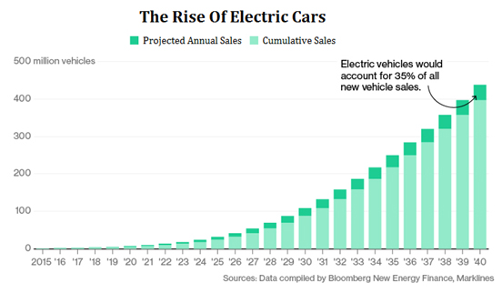
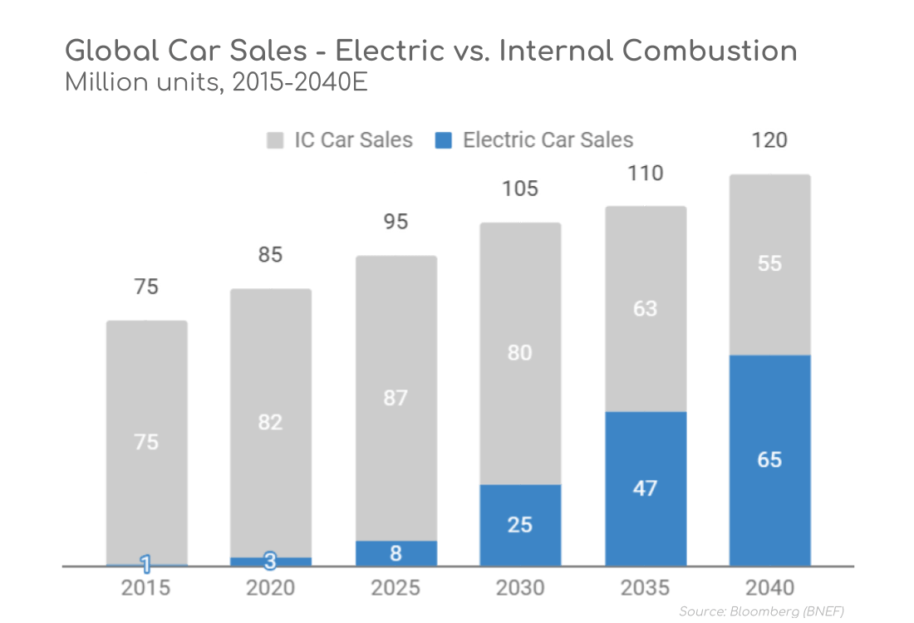
EV Market Overview (1) The growing economy of the electric car industry - Bing video

Slide 23
EV Market --US SALES

Slide 24
Reasons To Support EV Development

Slide 25
Five EV Take-ways
EVs owe their development to the convergence of several disruptive technologies (e.g., AI, IoT, lithium batteries, charging equipment) and government policies (fuel performance mandates, purchasing incentives). This mix should play out in favor of EV and Avs in the long term.
Currently there are no clear winners among car companies, OEMs or national suppliers and markets. The current race of for best technologies (and profitability) is open and ongoing.
EVs can be a great tool in disrupting negative environmental and global warming trends – a major shift away from fossil fueling and improved battery storage capability is essential.
In fact, overall progress in the energy sector is crucial -- with impacts that can change our approaches to national security (less spilling of blood for oil), as well as the shape and competitiveness of the national economy (e.g., international economic competitiveness, and the base current motor vehicle manufacturing,
EVs, especially when combined with AV technology, may provide the basis for a land use revolution if it changes vehicle ownership to a subscription system (e.g., reduction in parking space, less highway congestion). See Smart Cities discussions.

Slide 26
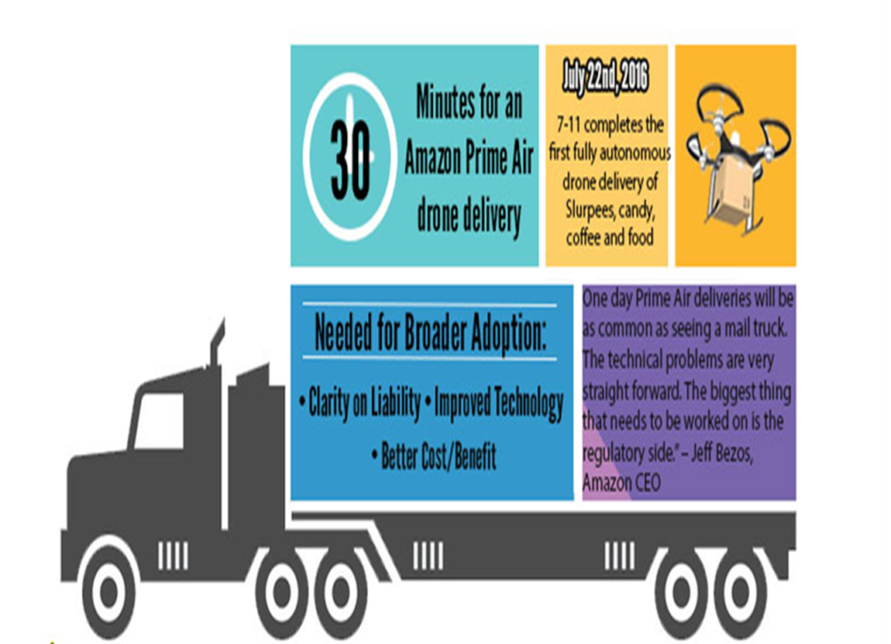
Drones and Delivery Bots 178) Can delivery drones and robots make it in "the last mile"? - YouTube
As a result of rising labor costs, many shippers and carriers are experimenting with technologies that reduce driver miles, such as delivery robots and drones.
Delivery in rural areas can be particularly expensive, where drivers often travel many miles between destinations to drop a single package. And delivery companies around the world are trying to reduce the cost of last-mile trips with drones.
UPS says that shaving off just one mile for each of its 66,000 drivers a day could save the company up to $50 million a year.
Delivery bots and drones have the potential to substantially lower carbon emissions and road congestion while satisfying customer on-demand requirements .
These technologies could revolutionize the way medical supplies and food are delivered. Both technologies are far smaller than trucks, more flexible in urban environments, and are naturally suitable for automation and electrification.
Others actively testing drones include Amazon, FedEx, numerous postal services and they are in use by Chinese retailer JD.

Slide 28
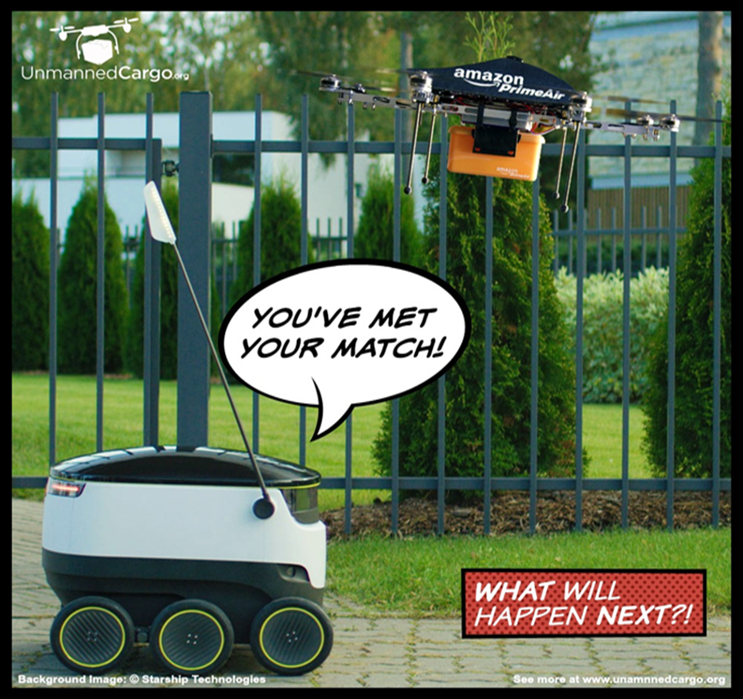
Drones and Delivery Bots (178) Is drone delivery practical? - YouTube
The deployment of delivery bots at numerous university campuses is already well underway. California-based startup Kiwi Campus has completed over 70,000 deliveries (e.g., food deliveries, groceries, school supplies) at the University of California, Berkeley since it began operations in 2017.
The company has over 150 Kiwibots in operation and is planning to expand its delivery business to several additional US campuses.
Major companies such as FedEx, Ford, and Amazon are also developing advanced sidewalk delivery bots—though these programs are more focused on residential deliveries.
In February 2019, FedEx released Roxo, the FedEx SameDay Bot, designed to help retailers make deliveries to nearby customers using an automated delivery device. The company is collaborating with partners such as Lowe’s, Pizza Hut, Target, Walgreens, and Walmart to assess how the bot could satisfy delivery needs.
Without any dedicated infrastructure for operation, it’s difficult to see how busy urban sidewalks or bike lanes can accommodate delivery bots without a plethora of accessibility and safety complications.
It’s also unclear whether city dwellers can accept sharing sidewalks or bike lanes with robots. Even on college campuses, delivery bots have faced challenges related to vandalism, theft, and resident opposition. They also have challenges related to impeding wheelchair users.

Slide 30
Final Thought

