Slide 1
Freight Disruptors -- Forces Can Change Everything
Exploring Disruption: A Supply Chain Focus on Trends and Technologies Effecting Transportation and the Rest of our Lives
Robert L James Esq.
OLLI Presentation Five – Disruptive SCM Focused Techologies
April 22, 2022

Slide 2
Focus on Disruptive Supply Chain Technologies
Define Supply Chain Management
Discuss its Historic Development
Highlight the New (Disruptive) Elements Facilitating Supply Chain 4.0 (best practices)
Focusing on Digitization– especially A.I. and Machine Learning Products:
Predictive Analysis;
Big Data Collection;
Collaborative and Transparent Data Transfers (e. g., Block Chain use)
Examine Present and Future Impacts
Explore Benefits and Negatives
Discuss Takeaway Points

Slide 3
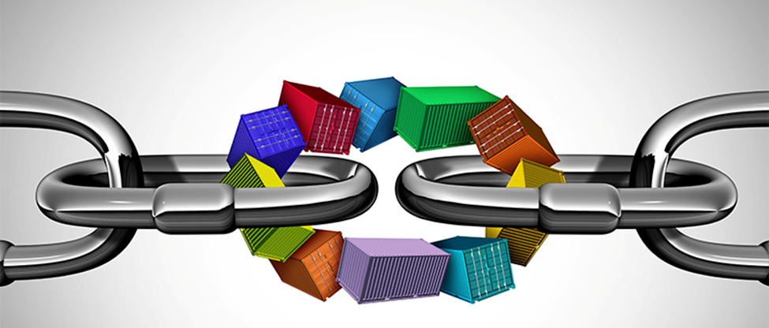
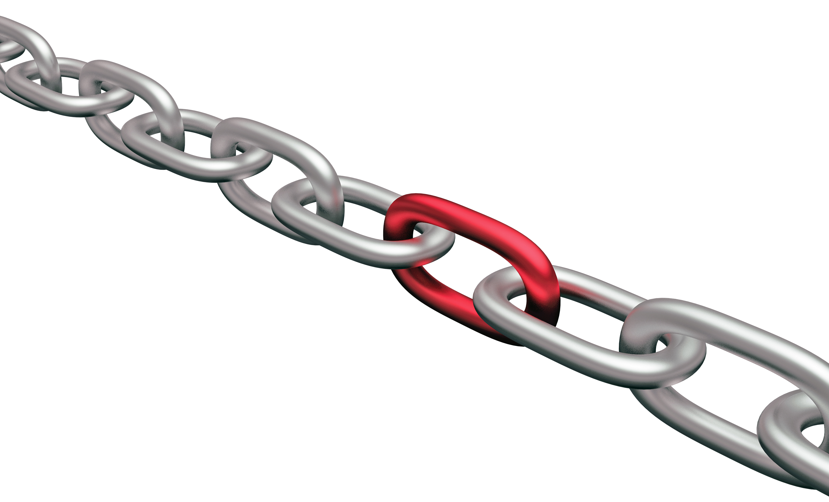
Supply Chain and its Management
Definition:
A supply chain is a network between a company and its suppliers to produce and distribute a specific product or service.
The entities in the supply chain include producers, vendors, warehouses, transportation companies, distribution centers, and retailers.
The functions in a supply chain include product development, marketing, operations, distribution, finance, and customer service.
Supply chain management results in lower costs and a faster production cycle. -- Investopedia
Video https://www.youtube.com/watch?v=bwl5ohf1qsg
Important Addendum:
Supply chain management is the practice of] incorporating a company’s social, environmental and economic goals into the coordination of inter-business processes to improve the long-term economic performance of the individual company and its supply chains.”
Source:

Slide 5
It Takes Many Partners to Build and Run a Supply Chain

Slide 6
A Simple History of Supply Chain Evolution
Pre-1900s: Local supply chains – restricted to regions railroads begin to expand markets.
1900-1950s: Supply chains continue to grow and extend globally. Military lessons in analytics, process mechanization and transportation management are applied, UPS other logistics specialists emerge.
1960s-70s: Physical distribution management emerges. Firms like FedEx and DPL joined a growing number of logistics providers. Time-dependent freight transportation concepts are applied as ‘physical distribution’ management
1963: IBM innovates around supply The National Council of Physical Distribution Management was formed. Also, IBM develops the first computerized inventory management and forecasting system.
1975: The first real-time warehouse management system was installed.
1980s: Inbound, outbound and reverse flows The development of personal computers, leads to improved supply chains planning capabilities, including spreadsheets and map-based interfaces. Supply chains are now considered an expensive, complex and important, business functions that include inbound, outbound and reverse flows. Reflecting this transition, the National Council of Physical Distribution Management changed its name to the Council of Logistics Management (CLM).
1982: Consultant Keith Oliver coined the term ‘supply chain management’
1990s-2000s: The technological revolution and globalization The 1990s to 2000s saw the introduction of more sophisticated management tools under the banner of Enterprise Resources Management (ERP) as well as advanced planning and scheduling, Global imports and exports rapidly expanded -- in 2006, US imports from China grew from US$ 45bn (1995) to over US$ 280bn.
1997: Amazon goes public1997: Amazon goes public, becoming the first internet retailer to secure one million customers.
2010 - 2020 Introduction of Industry 4.0 Driven by digital transformation strategies -- the last decade saw an exponential increase in technology adoption and innovation with the likes of AI, data, and Internet of Things (IoT) leading the way.
2020: COVID-19: the initial spread of the pandemic ground supply chains to a halt. Resultant shortages emphasized how vital their functions are. COVID impacts are spurring increased investment in supply chain localization and systems digitalization, A.I., including and Machine Learning products.
Source: https://supplychaindigital.com/logistics/timeline-history-supply-chain-management

Slide 7
Supply Chain Conceptual Development Timeline

Slide 8
Evolution of Industry from 1.0 to 4.0

Slide 9
Evolution of Industry from 1.0 to 4.0 Video: https://www.youtube.com/watch?v=v9rZOa3CUC8
The First Industrial Revolution between the late 1700s and early 1800s
During this period, manufacturing evolved from focusing on manual labor, aided by work animals to a more optimized form of labor supported by the use of water and steam-powered engines and other types of machine tools.
The Second Industrial Revolution began in the early part of the 20th century
It began with the introduction of steel and use of electricity in factories. Electricity enabled manufacturers to increase efficiency and helped make factory machinery more mobile. The introduction of mass production (e.g., the assembly line) boosted productivity.
The Third Industrial Revolution started in the late 1950s
Manufacturers began incorporating more electronic—and eventually computer— technology. The began to deemphasize analog and mechanical technology and rely more on digital technology and automation software.
The Fourth Industrial Revolution, or Industry 4.0 is on going
It takes the emphasis on digital technology from recent decades to a whole new level with the help of interconnectivity through the Internet of Things (IoT), access to real-time data, and the introduction of cyber-physical systems. Industry 4.0 offers a more comprehensive, interlinked, and holistic approach to manufacturing and the supply of which it is a part.
Source: What is Industry 4.0? | The Industrial Internet of Things | Epicor Singapore

Slide 11
There’s a Revolution Going On — Industry 4.0 Video: https://www.youtube.com/watch?v=T3HokK99Clk
Industry 4.0 refers to a new phase in the Industrial Revolution that focuses heavily on interconnectivity, automation, machine learning, and real-time data. Industry 4.0, which encompasses IIoT and smart manufacturing, marries physical production and operations with smart digital technology, machine learning, and big data to create a more holistic and connected ecosystem for companies that focus on manufacturing and supply chain management
Source: https://www.epicor.com/en-sg/blog/learn/what-is-industry-4-0/

Slide 13
Transition to a New Supply Chain Model
4.0 Digital Integrated Eco-System
Traditional
Notes:
A quick look at the grocery and supermarket industry points to various disruptions that players in the market must anticipate and manage proactively. According to research from IBISWorld, “the U.S. imports more than half of the fruit and nuts sold in the grocery stores,” leaving these supply chains open to a variety of upstream risks. To maintain competitive advantage, supermarkets gather point of sale (POS) data, used in forecasting projections and inventory management. Rarely is this data shared with upstream suppliers and logistics providers so all members of the network are prepared for action. Furthermore, actors at the bottom of the value chain, such as small holder farmers and cooperatives, do not push information downstream to help retailers prepare for supply chain disruptions such as environmental damage or crop destruction. This creates reactive supply chains, where partners are not prepared and the cost is passed down to end consumers. A better scenario would be to gather information from across the value chain, and in the case of foreseen disruptions find alternative suppliers that can temporarily fill the demands. Original article: https://www.tradeready.ca/2015/trade-takeaways/build-intelligent-supply-chain-putting-big-data-work/

Slide 14
Key Model Characteristics Where traditional supply chains plan and react, digital supply chains predict and prescribe actions to take.
Traditional
4.0 Digital Integrated Eco-system
Generally simple -- linear Information flows
Links limited to immediate producers, suppliers and customers.
Non-digitized and wells as digitized data.
Not focused on real time
Limited predictive capabilities
Lead supplier serves as information “Impresario”
Complex, holistic, broadly distributed information flows
End to end -- facilitates exchanges with sub- suppliers and customers
Aims for total digitization to maximize use of A.I and IoT tools
Real time information essential
Expanded predictive capabilities
Control tower manages network connections as well as collects and distributes data

Slide 15
Further Exploration of Model Differences video: https://www.youtube.com/watch?v=pdcJJpsOPGw

Slide 16
Essential 4.0 Manufacturing/Supply Chain Uses
Optimizing supply chain management with 4.0 solutions that give businesses greater insight, control, and data visibility across their entire supply chain. By leveraging supply chain management capabilities, companies can deliver products and services to market faster, cheaper, and with better quality to gain an advantage over less-efficient competitors.
Applying predictive maintenance/analytics tools to predict when potential problems are going to arise before they actually happen. Without IoT systems in place, preventive maintenance happens as a manual process based on routine or a temporal schedule. With IoT systems in place, preventive maintenance is much more automated and streamlined. Systems can sense when problems are arising or machinery needs to be fixed not just based on reactive questions like, “what has happened?,” or “why did it happen?,” but also on proactive questions like, “what is going to happen,” and, “what can we do to prevent it from happening?” They can pivot from preventive maintenance to predictive maintenance.
Improving asset tracking and optimization to become more efficient with assets at each stage of the supply chain, allowing companies to keep a better pulse on inventory, quality, and logistics efficiency. With IoT in place at a factory, employees can get better visibility into their assets worldwide. Standard asset management tasks such as asset transfers, disposals, reclassifications, and adjustments can be streamlined and managed centrally and in real time.
Better understanding and capturing market opportunities by gathering and analyzing E Commerce and store purchase preference data -- and by mining big data to discover patterns that predict future product and service preferences -- to grow market share and profits.

Slide 17
4.0 Deploys through the Digital Control Tower video: https://www.youtube.com/watch?v=PQexFtFhsPw
Source: https://www.linkedin.com/pulse/supply-chain-control-tower-jenis-sheth?trk=pulse-article

Slide 19
Technologies Impacting Supply Chain Functions
Source: BAIJ Paper - Revision 1.pdf (openrepository.com)

Slide 20
The Secret Sauce --4.0 Technologies Driving Change
Source: supplychaingamechanger.com

Slide 21
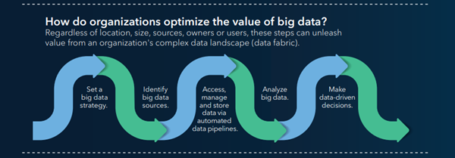
What is Big Data?
Video https://www.youtube.com/watch?v=bAyrObl7TYE
Big data refers to data that is so large, fast or complex that it's difficult or impossible to process using traditional methods. The act of accessing and storing large amounts of information for analytics has been around for a long time. -- SAS https://www.sas.com/en_us/insights/big-data/what-is-big-data.html

Slide 23
Supply Chain Sources of Big Data Videos: https://www.youtube.com/watch?v=Pu71o68yEDQ&t=7s
Source: https://www.resilinc.com/blog/5-reasons-to-pay-closer-attention-to-big-data-for-your-supply-chain/

Slide 25
Big Data Supply Chain Use Benefits
Reduce costs and improve margins
Access comprehensive data to gain a continuous integrated planning approach and real-time visibility into the disparate data that drives operational efficiency and actionable insights.
Better understand risks
Supply chain analytics can identify known risks and help to predict future risks by spotting patterns and trends throughout the supply chain.
Increase accuracy in planning
By analyzing customer data, supply chain analytics can help a business better predict future demand. It helps an organization decide what products can be minimized when they become less profitable or understand what customer needs will be after the initial order.
Achieve the lean supply chain
Companies can use supply chain analytics to monitor warehouse, partner responses and customer needs for better-informed decisions.
Prepare for the future
Companies are now offering advanced analytics for supply chain management. Advanced analytics can process both structured and unstructured data, to give organizations an edge by making sure alerts arrive on time, so they can make optimal decisions. Advanced analytics can also build correlation and patterns among different sources to provide alerts that minimize risks at little costs and less sustainability impact.
Survey Source: https://erpsolutions.oodles.io/blog/big-data-in-supply-chain/

Slide 26
Segway to the Blockchain

Slide 27
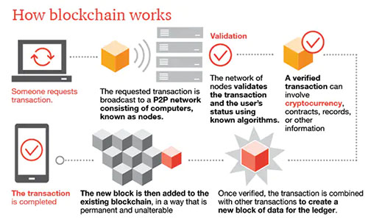
Block Chain Basics Video – extract from https://www.investopedia.com/terms/p/proof-stake-pos.asp
A blockchain is a distributed, or decentralized, ledger (DLY)—a digital system for recording transactions among multiple parties in a verifiable, tamperproof way. The ledger itself can also be programmed to trigger transactions automatically.
For cryptocurrency networks that are designed to replace fiat currencies, the main function of blockchain is to enable an unlimited number of anonymous parties to transact privately and securely with one another without a central intermediary.
For supply chains, it is to allow a limited number of known parties to protect their business operations against malicious actors while supporting better performance. Successful blockchain applications for supply chains will require new permissioned blockchains, new standards for representing transactions on a block, and new rules to govern the system—which are all in various stages of being developed.
Source https://hbr.org/2020/05/building-a-transparent-supply chain#:~:text=A%20blockchain%20is,of%20being%20developed.

Slide 28
Outside link to Investopedia Proof of State Video

Slide 29
Validation is a the Heart of Blockchain Security
Proof of Stake (POS) uses randomly selected miners to validate transactions. Proof of Work (POW) uses a competitive validation method to confirm transactions,
With proof-of-stake (POS), cryptocurrency owners validate block transactions based on the number of coins a validator stakes.
Proof-of-stake (POS) was created as an alternative to Proof-of-work (POW), the original consensus mechanism used to validate a blockchain and add new blocks.
Proof-of-stake (POS) is seen as less risky in terms of the potential for an attack on the network, as it structures compensation in a way that makes an attack less advantageous.

Slide 30
Blockchain Offers Major Supply Chain 4.0 Benefits Video https://www.youtube.com/watch?v=FtK65VH5OBg
Here are some key takeaways of how blockchain changes the future of the supply chain industry:
Fraud/Theft Elimination – Blockchain’s public ledger technology offers transparency and allows tracking the ownership history of various items such as diamonds, for example.
Transaction Process – The technology’s traceability enables wholesalers to pinpoint a product’s exact origin, which can save lives in case of contamination and gives the consumer trust in return.
Smart Contracts – Enabling the automation of the purchasing process as well as ensuring the quality, authenticity, and availability of goods.
Tracking – Blockchain facilitates the tracking of purchase orders, changes orders, receipts, shipment notifications, or other trade-related documents.

Slide 32
Examples of Early Blockchain Implementation
Walmart is utilizing Blockchain technology to add transparency to the food supply ecosystem by digitizing the entire food supply chain process. With the help of hyperledger fabric, the company making the process transparent, traceable, and reliable. Employees can track products for its origin, and it only takes a few seconds to scan a dozen of products to know where the fruit came from and where it is stored at present. Technology helps Walmart employees in tracking the origin of food in just a few seconds instead of days. Moreover, it reduces paper waste, automates the entire process, and accelerates supply chain transparency.
Ford In late January 2020, it was announced that the Ford Motor Company is preparing to utilize Blockchain to trace supplies of cobalt. Cobalt is an essential ingredient for electric car batteries. Ford, with IBM, plans to track its raw materials like cobalt from the suppliers. Utilizing Blockchain, the motor company wants to ensure that they are getting an authentic product to maintain its quality. When cobalt is mined, they will get on the ledger, and then the company can track where it’s going from there.
UPS is another one of the companies using Blockchain in the supply chain. In November 2018, this logistics giant joined the Blockchain in Trucking Alliance (BiTA) to bring increased transparency in the supply chain among all organizations. In March 2019, it was announced that UPS and e-commerce technology company Inxeption collectively rolled out a blockchain-powered platform to enhance merchant supply chains. UPS has also filed a patent for a blockchain system that would store package destination, movement, transportation method, and other crucial information, thus ensuring efficiency and transparency.
FedEx is seeing a single, standardized ledger, Blockchain, as an innovative technology to guard their chain of custody. To track its shipments, the shipping giant has adopted Blockchain. It has joined BiTA and launched a blockchain-powered pilot program to help make clear what data should be stored on Blockchain to best rectify customer disputes. Implementing Blockchain will enable clients to receive information in a faster and reliable manner and their customer service people to answer queries in a timely manner.
Bonus Video on Block Chain and food supply integrity -- https://www.youtube.com/watch?v=iTGoS5IXrqQ&list=PLvk6TIjIP8_2JHuHQ2SQ0C1ToiRFbe7I5&index=3
Source: Top Companies Using Blockchain to Increase Supply Chain Management - (blockchain-council.org)

Slide 33
In Sum --Supply Chain Management Goals Are Simple
But ---

Slide 34
Last Thoughts
Industry 4’0 and its supply chain counterparts are part of a seemingly endless effort to make manufacturing and commerce more efficient and profitable. New technology is always aborning to accomplish this end -- and in doing so -- make changes that are highly disruptive to status quo systems.
This is true of the 4.0 technologies that we have reviewed today. Throughout this course on disruption, we’ve seen a pattern of small innovators looking for new markets and large firms realizing, (sometimes too late) that these innovations will threaten the existence of their businesses. Now large firm are more inquisitive about technological change and more acquisitive regarding start up firms.
It is said that an army travels on its stomach. Also, it can be said that the end to end and movement of goods is travels on the quality and availability of the data that facilitates these processes. Thus importance of new data management should not be underestimated.
It is said that war is too important to be left to the generals. So too it can the understanding and application of new technologies is too important to be left solely to increase economic gain. Many emerging technologies -- be they big data or blockchain -- have overall social and environmental development costs that are too high not to be weighed tempered by public concern and,as necessary, self or governmental regulation.

Slide 35
Bonus Material -- Glossary of 12 Key Industry 4.0 Terms
Enterprise Resource Planning (ERP): Business process management tools that can be used to manage information across an organization.
IoT: IoT stands for Internet of Things, a concept that refers to connections between physical objects like sensors or machines and the Internet.
IIoT: IIoT stands for the Industrial Internet of Things, a concept that refers to the connections between people, data, and machines as they relate to manufacturing.
Big data: Big data refers to large sets of structured or unstructured data that can be compiled, stored, organized, and analyzed to reveal patterns, trends, associations, and opportunities.
Artificial intelligence (AI): Artificial intelligence is a concept that refers to a computer’s ability to perform tasks and make decisions that would historically require some level of human intelligence.
M2M: This stands for machine-to-machine, and refers to the communication that happens between two separate machines through wireless or wired networks.
Digitization: Digitization refers to the process of collecting and converting different types of information into a digital format.
Smart factory: A smart factory is one that invests in and leverages Industry 4.0 technology, solutions, and approaches.
Machine learning: Machine learning refers to the ability that computers have to learn and improve on their own through artificial intelligence—without being explicitly told or programmed to do so.
Cloud computing: Cloud computing refers to the practice of using interconnected remote servers hosted on the Internet to store, manage, and process information.
Real-time data processing: Real-time data processing refers to the abilities of computer systems and machines to continuously and automatically process data and provide real-time or near-time outputs and insights.
Ecosystem: An ecosystem, in terms of manufacturing, refers to the potential connectedness of your entire operation—inventory and planning, financials, customer relationships, supply chain management, and manufacturing execution.
Cyber-physical systems (CPS): Cyber-physical systems, also sometimes known as cyber manufacturing, refers to an Industry 4.0-enabled manufacturing environment that offers real-time data collection, analysis, and transparency across every aspect of a manufacturing operation.
Source: What is Industry 4.0? | The Industrial Internet of Things | Epicor Singapore

